Slide 1

Medusa Implementation
By:
Sepand Haghighi
Vahid Amini
Amin Fotovat

Slide 2
Overview
Previous Talk
Implementation
Results

Slide 3
Let’s Flashback!
Why graphs?
Many real-world applications:
Social Networks
Web link analysis
Challenging CUDA code?
Solution: Sequential Programming Framework

Slide 4
GPU As An Accelerator
GPU-based solutions vs CPU-based
Improved performance
Limited to specific graph operations
Optimization for each graph processing task

Slide 5
What Medusa Offers
A Soft Framework
Simplify Programming
Novel Graph Programming Model
Edge-Message-Vertex
Suitable for Parallel Graph Processing

Slide 6
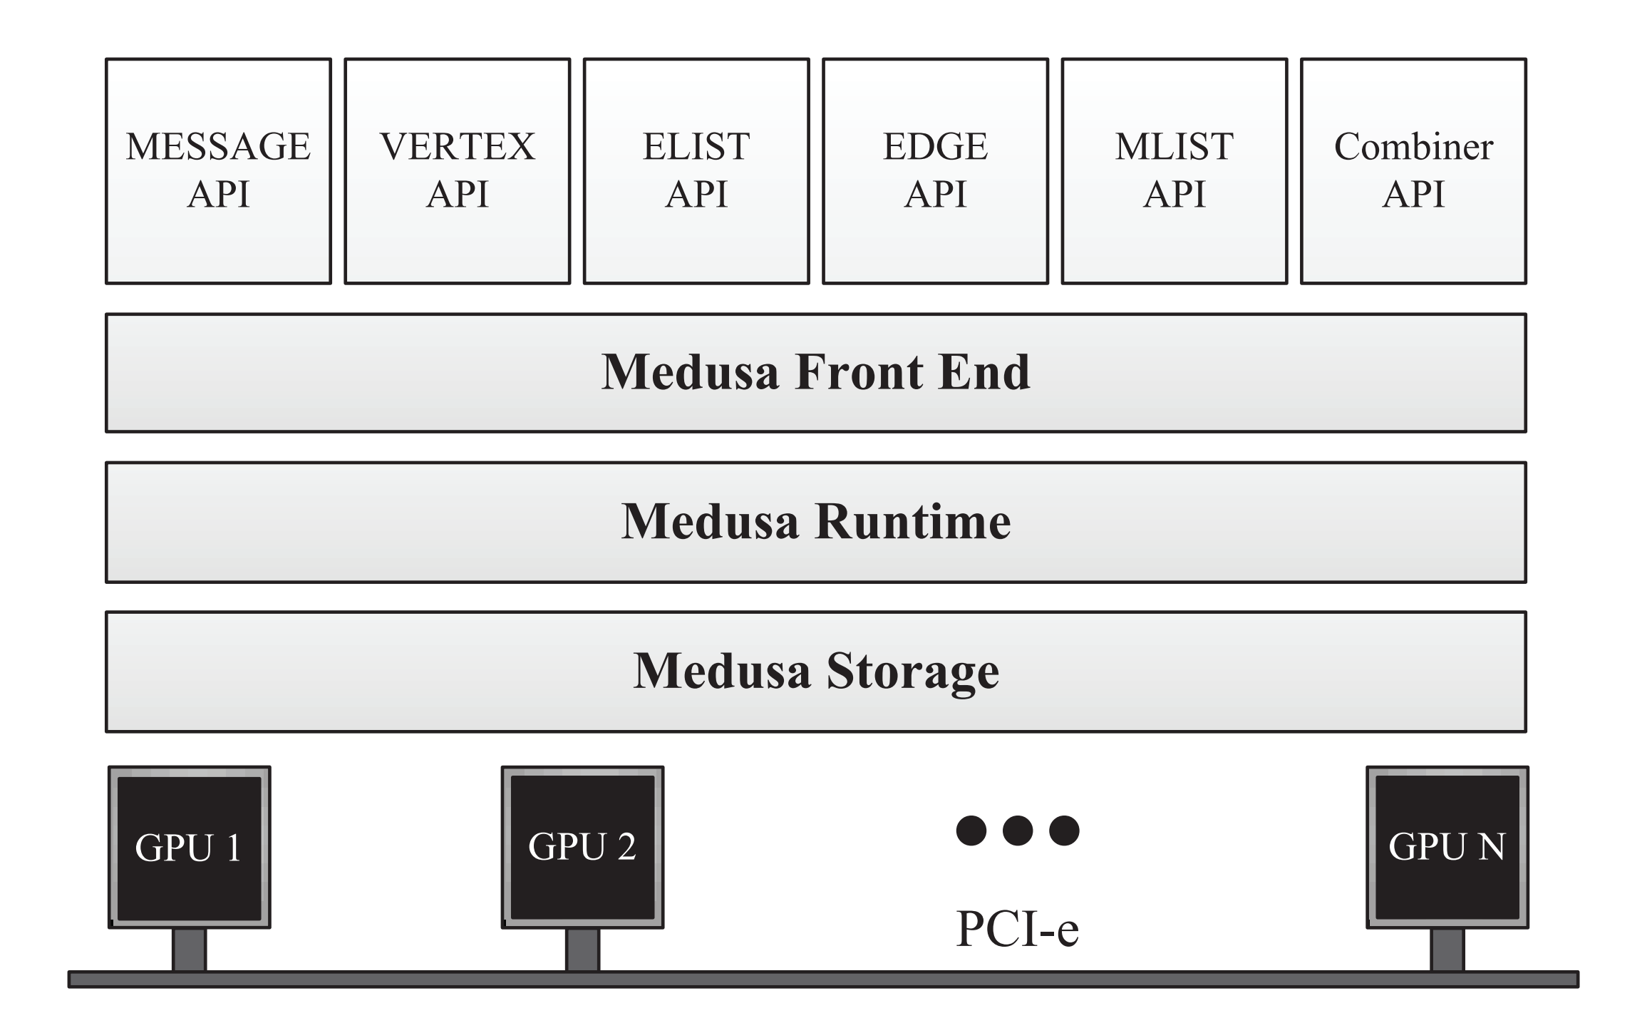
Overview of Medusa

Slide 7
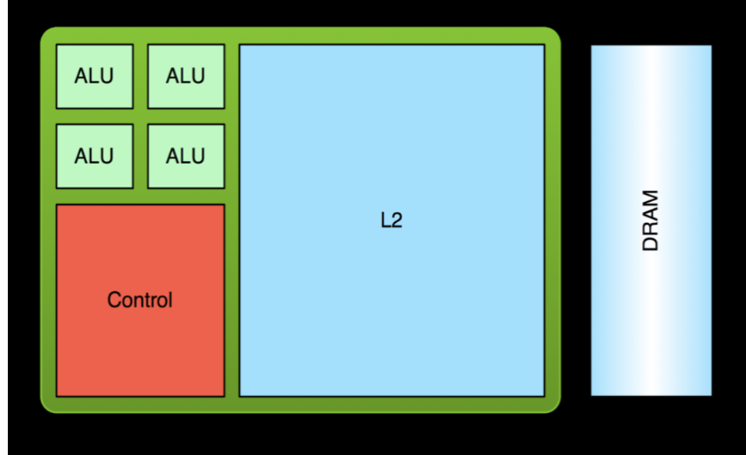
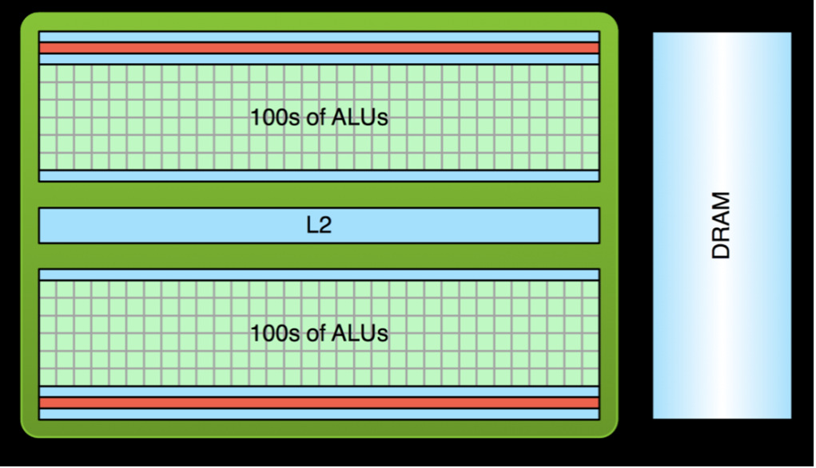
GPU vs CPU

Slide 8
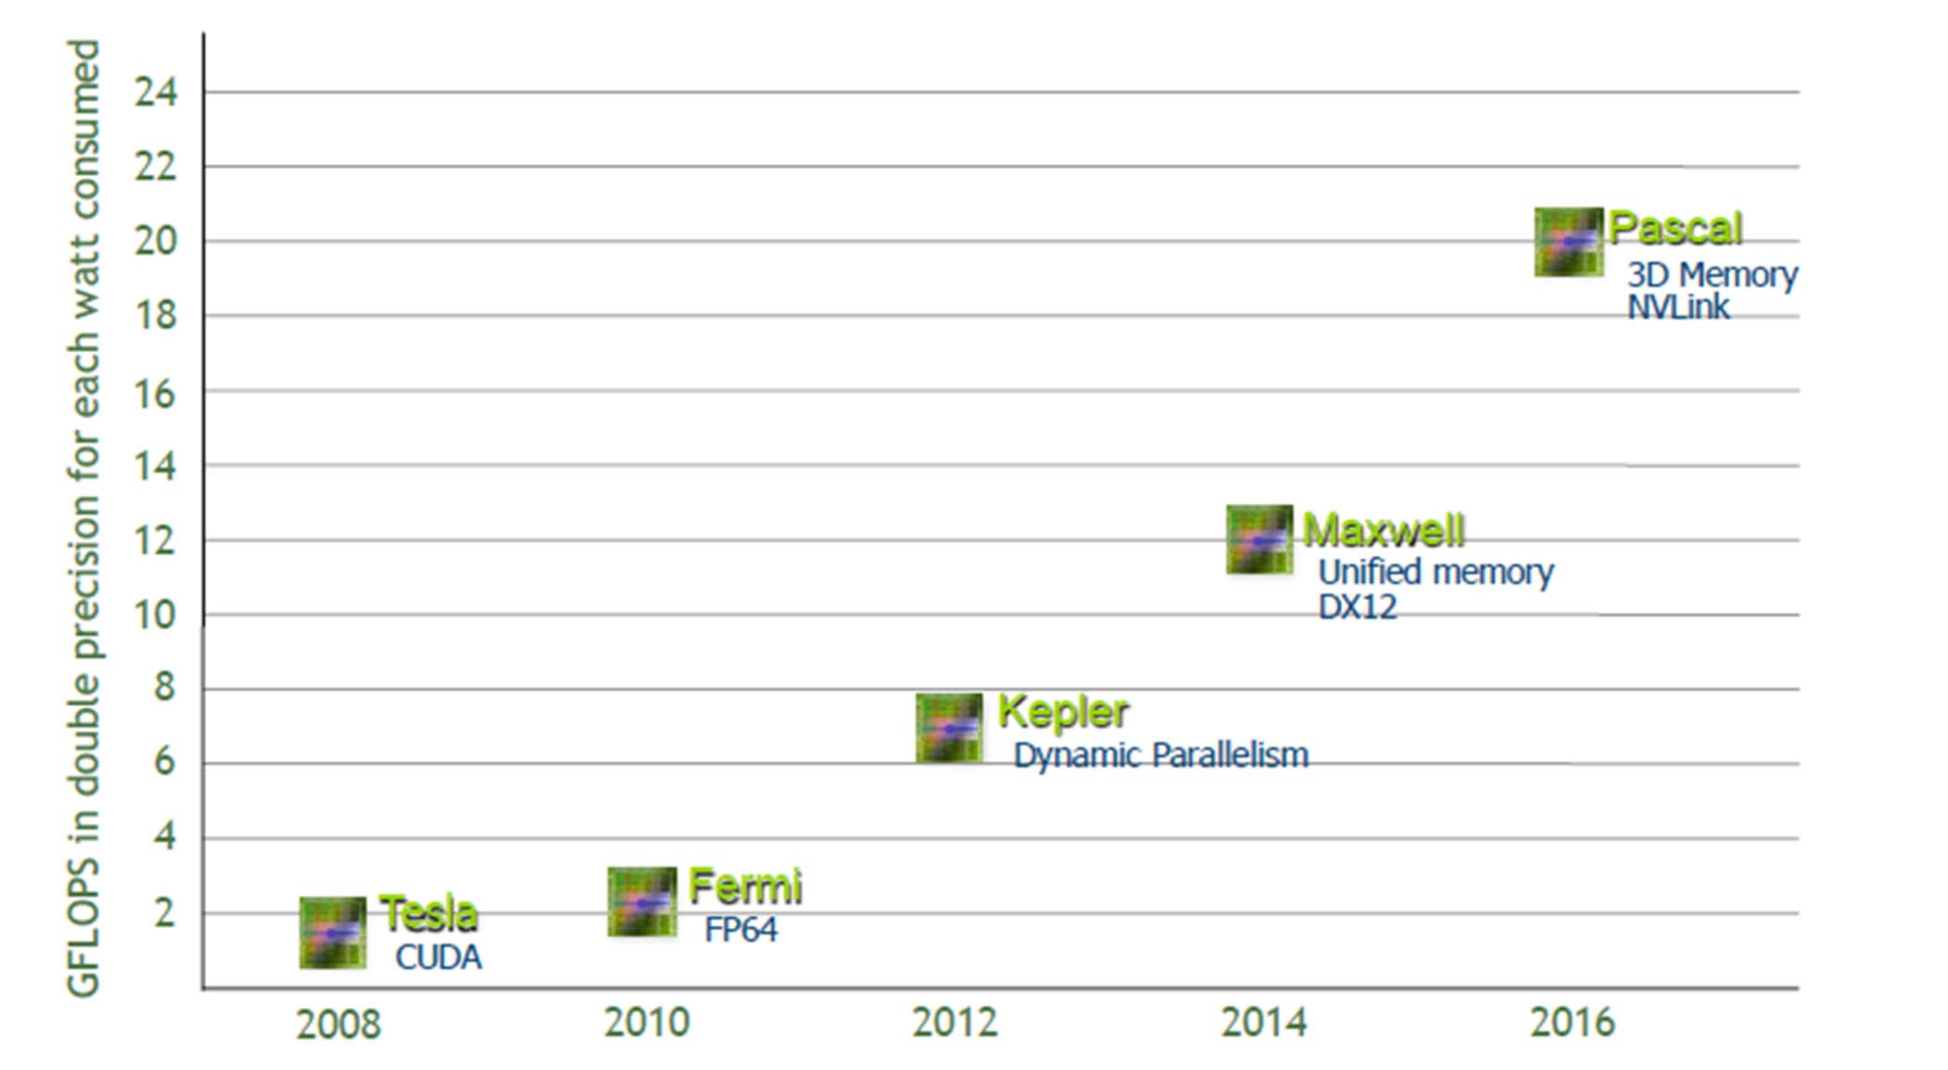
Hardware Generation

Slide 9
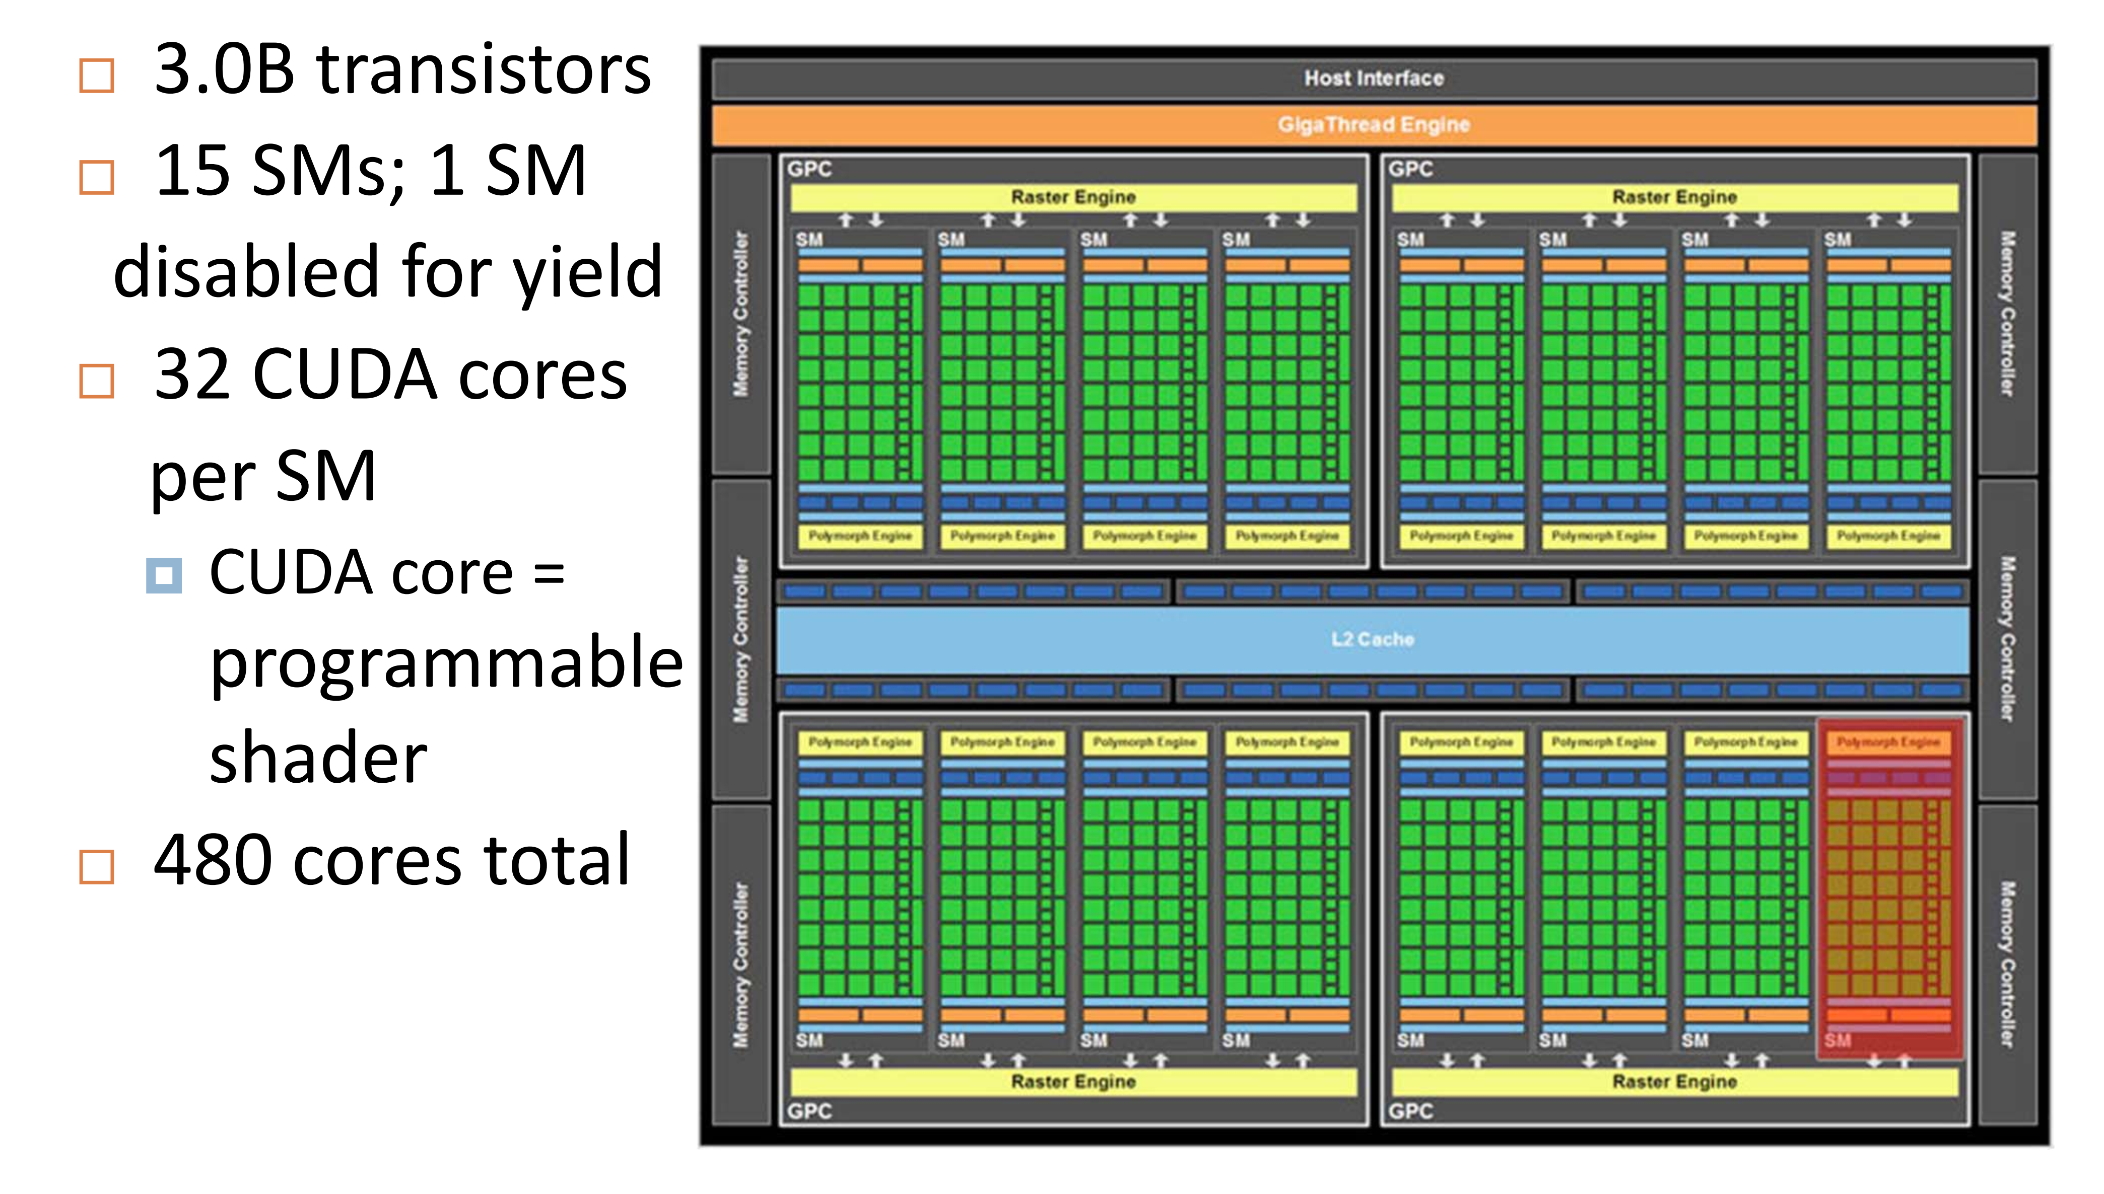
Nvidia Fermi GPU (2010)

Slide 10
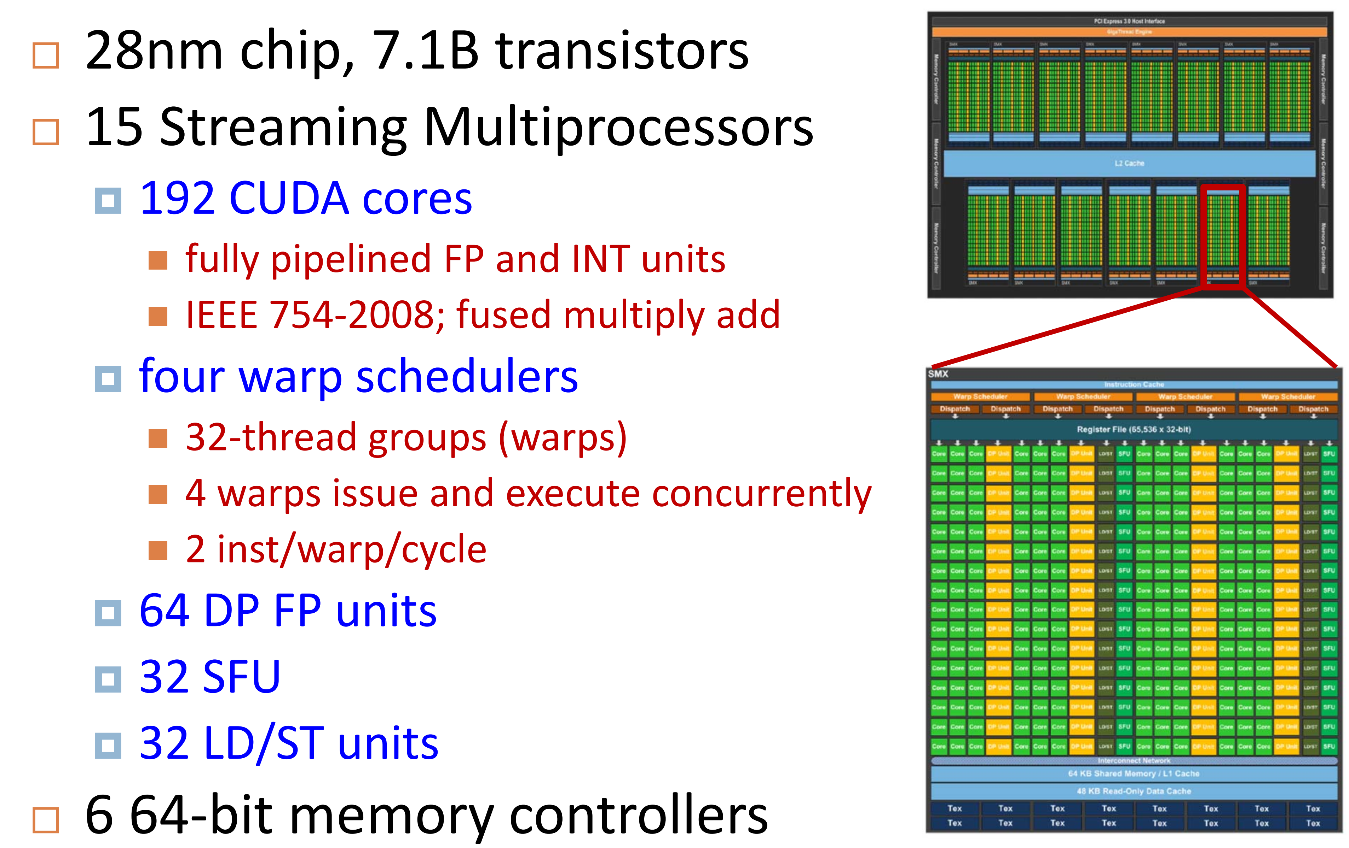
Nvidia Kepler (2012)

Slide 11
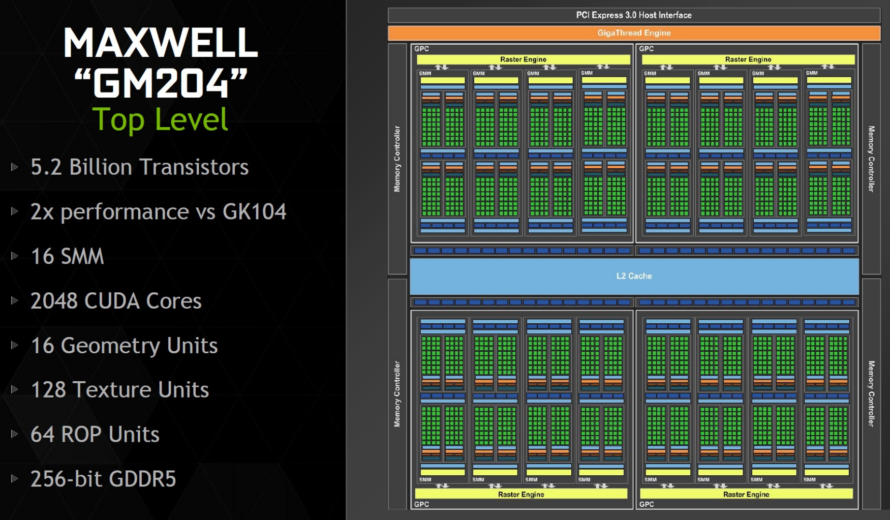
Nvidia MAXWELL (2015)

Slide 12
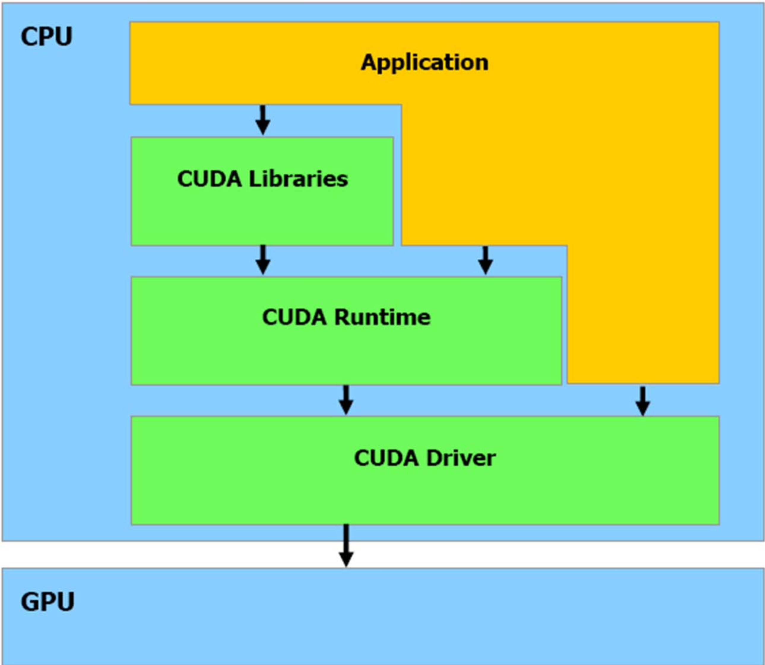
CUDA Software Stack

Slide 13
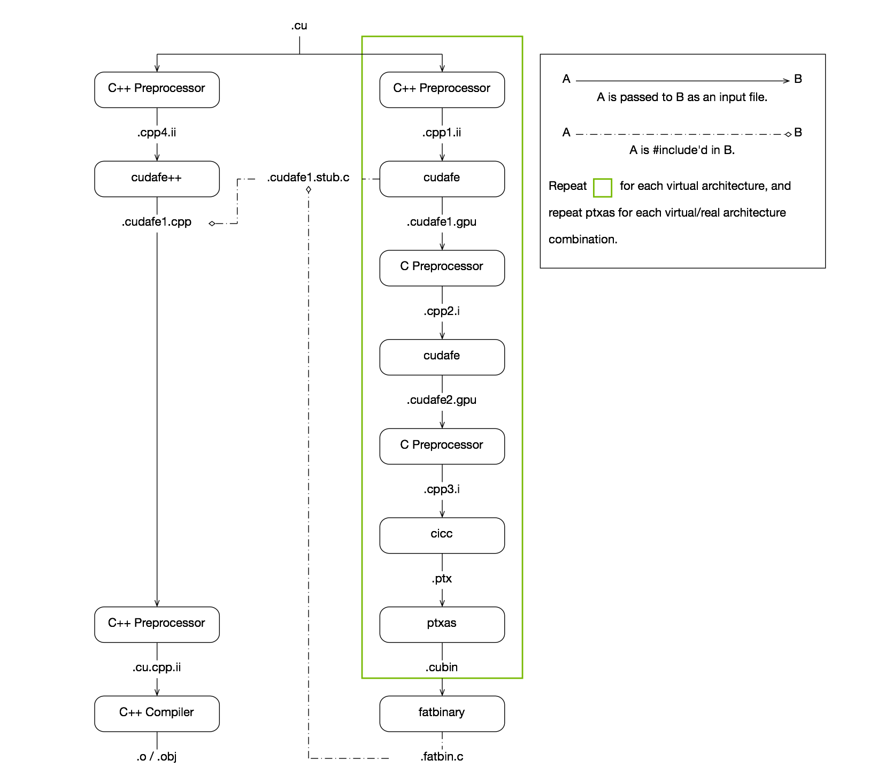
CUDA Compilation

Slide 14
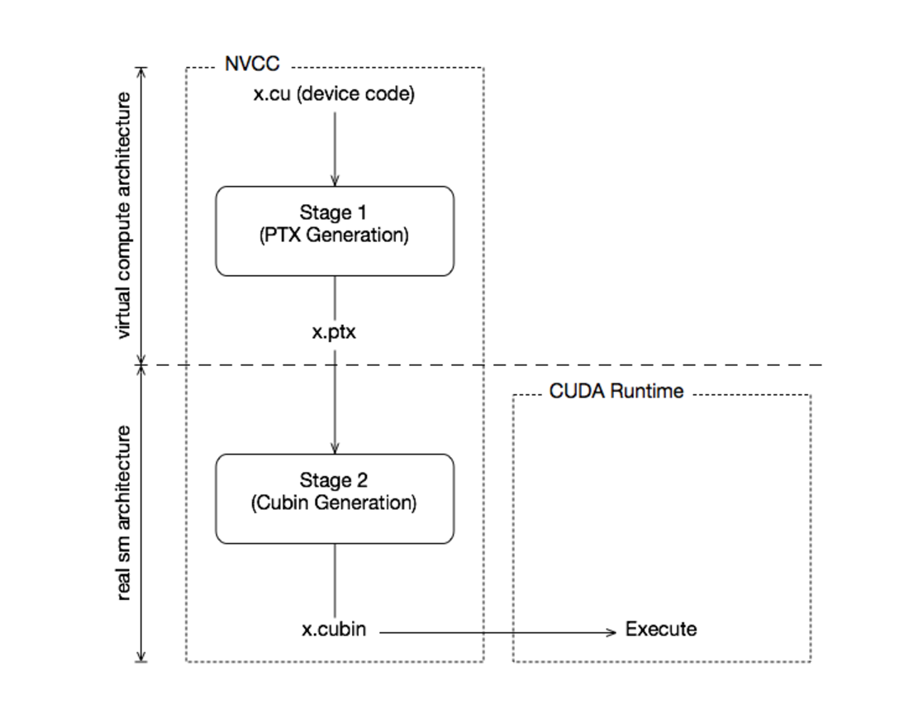
CUDA Compilation

Slide 15
CUDA BFS Sample
void BFSGraph( int argc, char** argv)
{
char *input_f;
if(argc!=2){
Usage(argc, argv);
exit(0);
}
input_f = argv[1];
printf("Reading File\n");
//Read in Graph from a file
fp = fopen(input_f,"r");
if(!fp)
{
printf("Error Reading graph file\n");
return;
}
int source = 0;

Slide 16
CUDA BFS Sample
Node* d_graph_nodes;
cudaMalloc( (void**) &d_graph_nodes, sizeof(Node)*no_of_nodes) ;
cudaMemcpy( d_graph_nodes, h_graph_nodes, sizeof(Node)*no_of_nodes, cudaMemcpyHostToDevice) ;
//Copy the Edge List to device Memory
int* d_graph_edges;
cudaMalloc( (void**) &d_graph_edges, sizeof(int)*edge_list_size) ;
cudaMemcpy( d_graph_edges, h_graph_edges, sizeof(int)*edge_list_size, cudaMemcpyHostToDevice) ;
//Copy the Mask to device memory
bool* d_graph_mask;
cudaMalloc( (void**) &d_graph_mask, sizeof(bool)*no_of_nodes) ;
cudaMemcpy( d_graph_mask, h_graph_mask, sizeof(bool)*no_of_nodes, cudaMemcpyHostToDevice) ;

Slide 17
CUDA Kernel
#ifndef _KERNEL_H_
#define _KERNEL_H_
__global__ void
Kernel( Node* g_graph_nodes, int* g_graph_edges,
…
{
int tid = blockIdx.x*MAX_THREADS_PER_BLOCK + threadIdx.x;
if( tid<no_of_nodes && g_graph_mask[tid])
{
g_graph_mask[tid]=false;
for(int i=g_graph_nodes[tid].starting; i<(g_graph_nodes[tid].no_of_edges + g_graph_nodes[tid].starting); i++)
{
int id = g_graph_edges[i];
…

Slide 18
CUDA Kernel
#ifndef _KERNEL_H_
#define _KERNEL_H_
__global__ void
Kernel( Node* g_graph_nodes, int* g_graph_edges,
…
{
int tid = blockIdx.x*MAX_THREADS_PER_BLOCK + threadIdx.x;
if( tid<no_of_nodes && g_graph_mask[tid])
{
g_graph_mask[tid]=false;
for(int i=g_graph_nodes[tid].starting; i<(g_graph_nodes[tid].no_of_edges + g_graph_nodes[tid].starting); i++)
{
int id = g_graph_edges[i];
…

Slide 19
IMPLEMENTATION

Slide 20
Medusa Requirements
Programming
CUDA 4.2
C++ 03
Build
gcc
CUDA nvcc

Slide 21
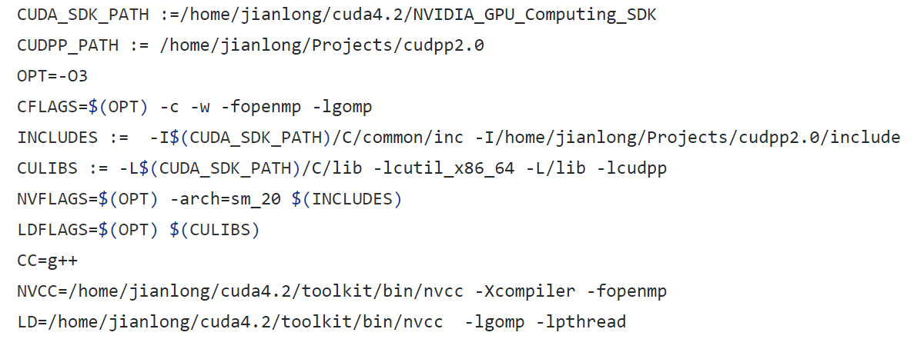
How to build Medusa

Slide 22
Difficulties
Bad Documentation
About 4000 lines of code without comments
No details about compiler version
Cuda backward compatibility problem
Old Nvidia Architecture Kernels
Graph Generator Problem

Slide 23
Maxwell Compatibility Problem
Need PTX if application built using CUDA v. 2.1~ 5.5
Different major version number aren’t compatible with each other
http://docs.nvidia.com/cuda/maxwell-compatibility-guide/#axzz4iGD7BuLS

Slide 24
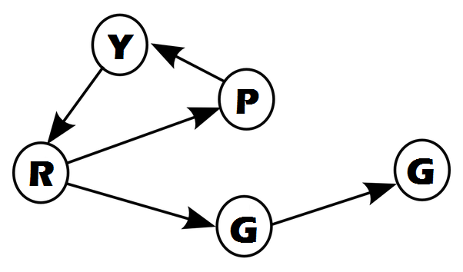
Python Random Graph Generator
Based on DIMACS
Written in Python
Available on our repo (Github)
http://github.com/sepandhaghighi/pyrgg

Slide 25

DIMACS Standard
A graph contains n nodes and m arcs
Nodes are identified by integers 1...n
Graphs can be interpreted as directed or undirected
Graphs can have parallel arcs and self-loops
Arc weights are signed integers

Slide 26
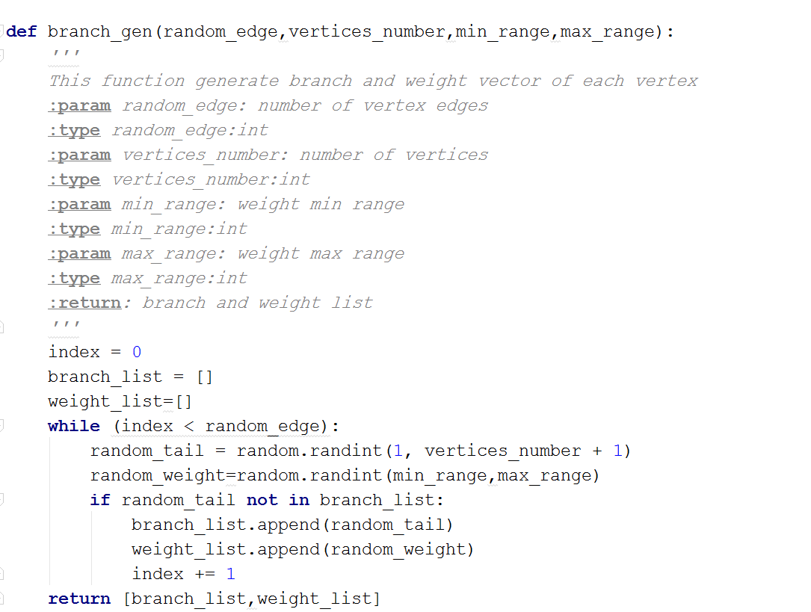
Pyrgg (branch_gen)

Slide 27
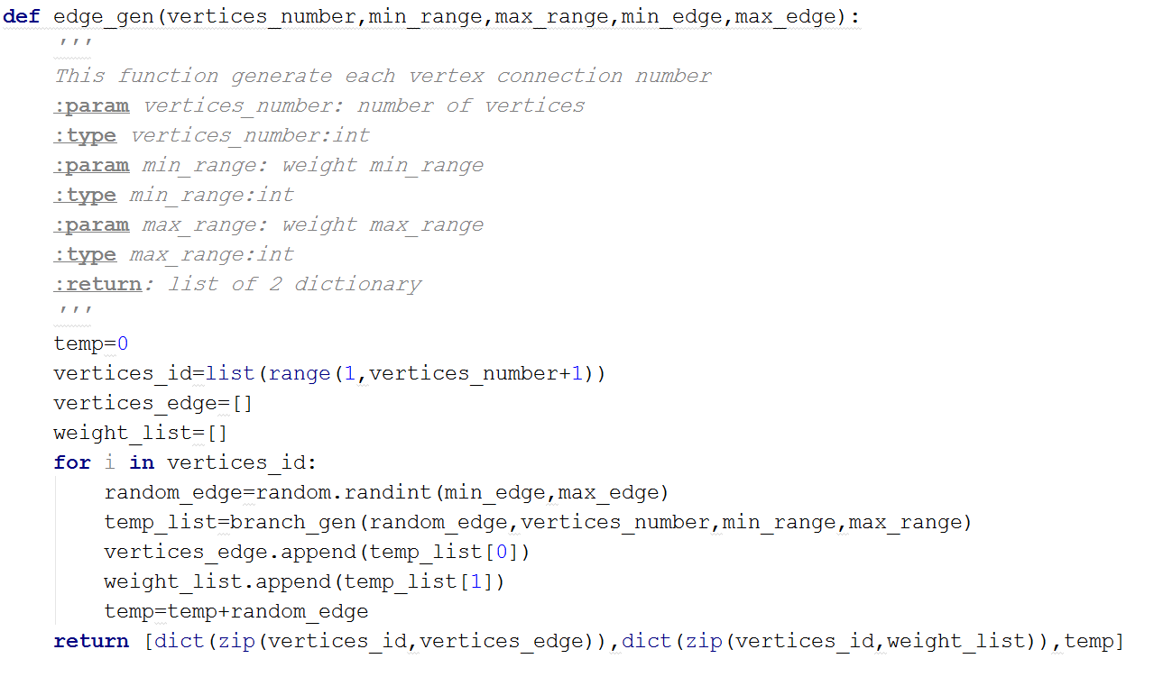
Pyrgg (edge_gen)

Slide 28
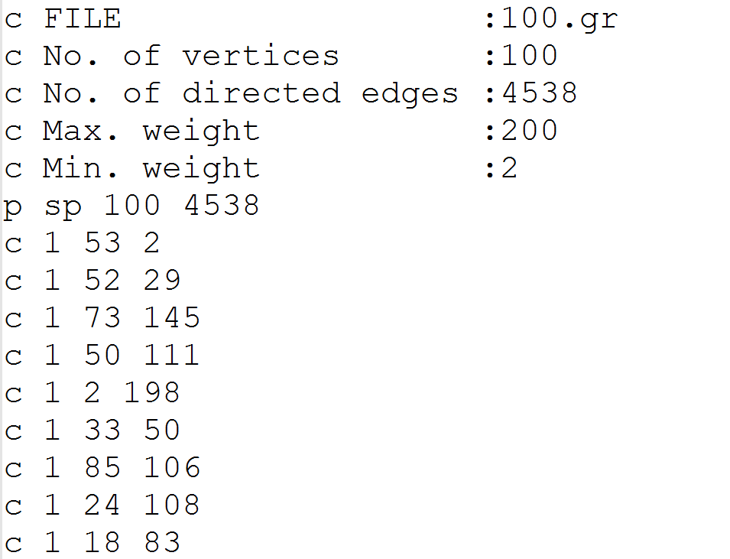
Output

